Slide 1
SCASC Advisor Information Session
District Rally 2019
Bonita Guram, executive director
Roger Mize, assistant executive director

Slide 2
SCASC
South Carolina Association of Student Councils
Membership runs from Sept. 1- Aug. 31
Dues $50 (Regular Membership)
Dues $60 (Palmetto Membership) $10 goes to provide scholarships to the summer camp. Palmetto members get to bring on extra delegate to the summer camp.
Website: www.thegavel.org
Mascot: Mr. Cakalaki

Slide 3
SCASC Goal
The goal is to unify student leaders from across the state by building relationships through leadership training, acknowledging individual and school excellence, and providing opportunities to enhance their life skills for future endeavors.

Slide 4
Mission Statement
The mission of the South Carolina Association of Student Councils, as a non-profit, student led organization, is to train and develop leaders to take action within their communities, built on the values of integrity, respect, and service.

Slide 5
Mission
Service
Integrity
Respect

Slide 6
Logo

Slide 7
Motto
Do it Right,
Make it Big,
Give it Class !!

Slide 8
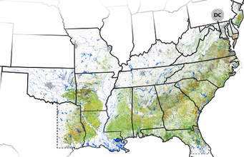
SASC
Southern Association of Student Councils
North Carolina, South Carolina, Tennessee, Georgia, Virginia, West Virginia, Missouri Kentucky, Mississippi, Arkansas, Louisiana, Florida, Alabama, Oklahoma, Texas (15)
Membership – January 1- December 31
Dues $75, $100, $150
Website- www.sascschools.com
SASC Conference- (Oct. 26-28, 2019) $170
Sulphur High School, Sulphur Louisiana

Slide 9
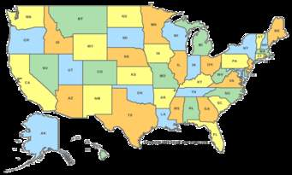
NASC
National Association of Student Councils
Membership runs July 1- June 30
Dues $95
Website: www.nasc.us
NAWD Conference – Atlanta, GA
(Dec. 6-8) Not for students. ($325)
NASC Conference – June 22-24, 2020
(Eaglecrest High School, Centennial, Colorado)
(approximately $365)
SCASC usually helps cover the cost of state and district officers and sometimes their advisors.

Slide 10
SCASC Conferences and Workshops District Rally
District Rallies (October and November)
Hosted by the student elected District Chair at their school.
If you are not able to attend the rally in your district, you are welcome to attend any rally in the state. You just need to get the necessary paperwork.

Slide 11
Districts by County
District 1 | Orangeburg, Bamberg, Allendale, Hampton, Colleton, Dorchester, Berkeley, Charleston, Jasper, Beaufort
District 2 | Marlboro, Dillon, Marion, Horry, Georgetown, Williamsburg, Clarendon, Sumter, Lee, Darlington, Florence
District 3 | McCormick, Edgefield, Saluda, Lexington, Aiken, Barnwell, Calhoun
District 4 | York, Chester, Fairfield, Richland, Kershaw, Lancaster, Chesterfield
District 5 | Oconee, Pickens, Greenville
District 6 | Anderson, Abbeville, Greenwood, Laurens, Newberry, Spartanburg, Union, Cherokee
 | Allendale, Bamberg and Orangeburg moved from 3 to 1, Abbeville and Anderson moved from 5 to 6. Saluda moved from 6 to 3

Slide 12
SCASC Conferences and Workshops Advisor Workshop
For all Student Council Advisors, old and new, middle level or high school. Get ideas and strategies to use with your council.
Monday, January 27, 2020
9:00 am- 2:30 pm
Cost - $50 per advisor
Lexington 2 Innovation Center, West Columbia, SC
Daniel Bailey, our association president, will be managing the workshop. All forms will be sent to him at Airport High School.

Slide 13
SCASC Conferences and Workshops Middle Level Workshop
For middle level students. Limit 3 per school.
Monday, January 27, 2020
9:00 am- 2:30 pm
Cost - $40 per student
Lexington 2 Innovation Center, West Columbia, SC
Daniel Bailey, our association president, will be managing the workshop. All forms will be sent to him at Airport High School.

Slide 14
SCASC Conferences and Workshops State Convention
For middle and high school students and advisors. Limit 8-10 per school.
Wade Hampton High School, Greenville, SC
March 13-15, 2020
Friday 4:30 pm- Sunday 12:30 pm
Cost - $ 100 per delegate (students) $75 (advisors)
Theme: 2020 Vision of Leadership
Home Stay- Some students will stay with host families
Hotel: Advisors and some students in selected hotels
Elections for new state officers held at Convention.

Slide 15
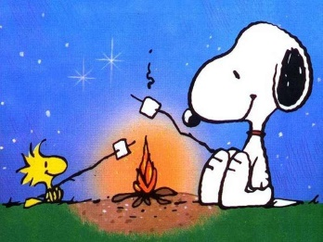
SCASC Conferences and Workshops Summer Leadership Camp
Amanda Pinson is the Camp Coordinator
July 12-16, 2020
Cherry Grove, Myrtle Beach, SC
Online registration date TBA
Cost $260 (School checks or money orders only, no personal checks)
Deadline for materials and payment (1st week in May)
Camp fills up quickly so plan ahead.
Camp discussion and video

Slide 16
Typical Camp Day
Day One (Sunday)— Delegates will be assigned to a council who will become a family for the week. Delegates will work with their council to solve an assigned problem during the week. Delegates will meet their cabin mates and learn how they can win Cabin of the Day/Week. After dinner, delegates will hear from the camp consultant.
Days Two and Three (Monday and Tuesday) —After a hearty breakfast and cabin cleaning, delegates will attend Skills Sessions taught by our experienced senior staff members. After lunch, they will meet several times with their council, attend electives to find out what other schools are doing on specific topics, enjoy some free time, and then dinner. After dinner, delegates will work with the camp consultant. On Tuesday, there will be a talent show after dinner.
Day Three (Wednesday)—In addition to the Skills Sessions, delegates will have intensive training in their respective positions on council. After lunch, councils compete in a field day activity and finish their report for Council of the Week.
Day Four (Thursday) - After breakfast and packing, delegates will fine tune their council’s skit and present it to the camp. Final awards will be given! Time to say GOOD-BYE until we see you at the District Rallies! The program will end by 11:30 a.m. Please have your transportation there by 11:30. Supervision will not be available for students after 12 noon. Lunch is not served on Thursday.

Slide 17
Awards (Advisor of the Year)
Apply with Google forms. See website.
Due Oct. 14, 2019
One middle level, one high school level
State winners announced at the state convention.
The state winners will then apply for the national advisor of the year.

Slide 18
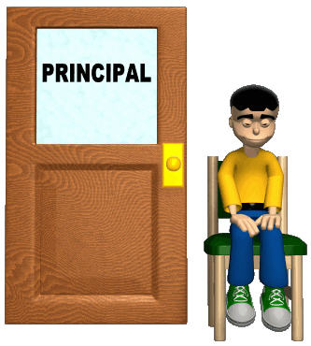
Awards Administrator of the Year
Apply with Google forms. See website.
Due November 11, 2019
Any school administrator who is supportive of your student activities
Winner announced at the state convention.

Slide 19
Awards (Honor Council)
This is a process that helps you evaluate your council without competing with any other councils. The total points determine status for Bronze, Silver or Gold.
Due Feb. 14, 2020
Complete on Google Forms or Scan and send hard copy. See website.

Slide 20
Awards (Terry McCoy Hall of Fame)
Mr. McCoy was the executive director for SCASC for 30 years and did great work to instill leadership skills in South Carolina students.
Each member school can nominate one student from that school. This student should exemplify qualities of a leader that goes above and beyond.
All students nominated will be automatically added to the Hall of Fame. Recognition and certificates will be given at the State Convention.
This is a one page application form available on the website.
All applications are to be submitted online no later than February 28, 2020.

Slide 21
Awards (Project Awards)
Project Entries should be turned in during registration at the state convention.
You may submit up to 3 projects.
Current SCASC advisors will read and judge projects during the convention this year.
Project Awards will be presented at the awards banquet during the State Convention.
Categories: Community Service, Leadership activities, Recognition, Recreational activities, School Service, School Pride, School Spirit, Fund Raising, Video, and Digital Memory Book.
For projects entry forms and the judges score sheet, please refer to the SCASC website under Awards.

Slide 22
Awards (Scrapbook Awards)
The scrapbook award is based on documentation of council activities by submitting a scrapbook outlining your council projects for the year.
The scrapbook must be developed and organized using the rubric criteria.
For detailed information, please refer to the SCASC website for the rubric.

Slide 23
SCASC Elections
Any student running for office must have already attended the summer leadership camp.
Advisors must request applications from the executive director beginning January 1 and applications must be completed by February 14.
Campaign rules must be followed and no campaigning of any kind should begin until after candidates have read the campaign rules and have received confirmation from the executive director .

Slide 24
SCASC Elections (District Officers)
Six Districts
District Elections will be held at the District meetings on Saturday, March 14 at the state convention.
District Chair (Must host district rally)
District Vice Chair (In charge of rally workshops)
District 2nd Vice Chair (Middle School student, helps with workshops and rally) (May be an 8th grader with permission to serve as a 9th grader from the high school advisor.)

Slide 25
SCASC Elections (State Officers)
State officer elections will be held on Sunday, March 15 at the state convention.
President (Must Host State Convention)
Vice President (In charge of convention workshops)
2nd Vice President (middle school student, helps with workshops and state convention)
Recording Secretary (keeps minutes at executive meetings)
*(New Position) Historian (Must take pictures and record events throughout the year.)
*(New Position) Parliamentarian (In charge of elections and parliamentary procedures.

Slide 26
Appointed Officer
Corresponding Secretary (Appointed by the Executive Director) (Assist the executive director and helps with mailings, e-mails, messaging and correspondence.

Slide 27
Questions??? Concerns Ideas
Bonita Guram- scascguram@gmail.com
Roger Mize –
rmize@lexrich5.org

